Slide 1


Retrieval Augmented Generation (RAG)
Dani Siaj / Carlos Rodríguez
Data Science & Machine Learning Bootcamp 01/11/2024

Slide 2
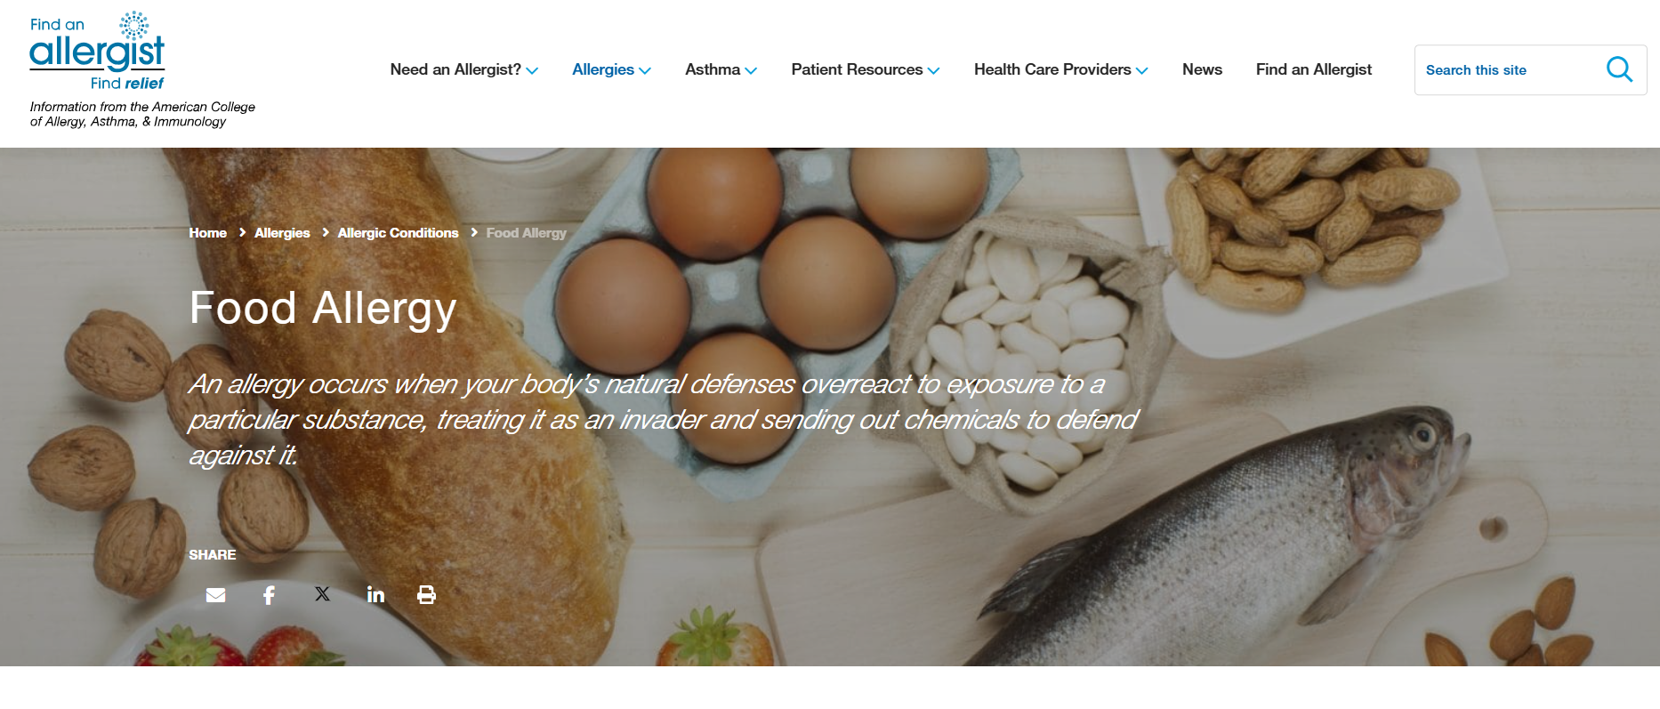
DATA SET
We created a .pdf (9 pages) with information from the American College of Allergy, Asthma and Immunology (ACAAI). NO NEED FOR A EDA
Data Science | Machine Learning

Slide 3
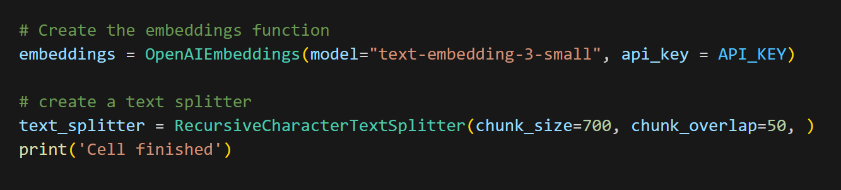
MODEL SELECTION
Data Science | Machine Learning

Slide 4
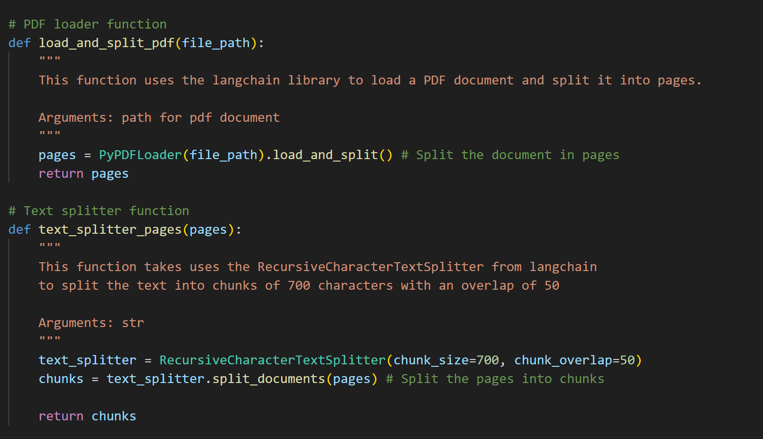
LOAD AND PROCESS DATA
Open PDF
Split by pages
Split pages in chunks
Data Science | Machine Learning

Slide 5
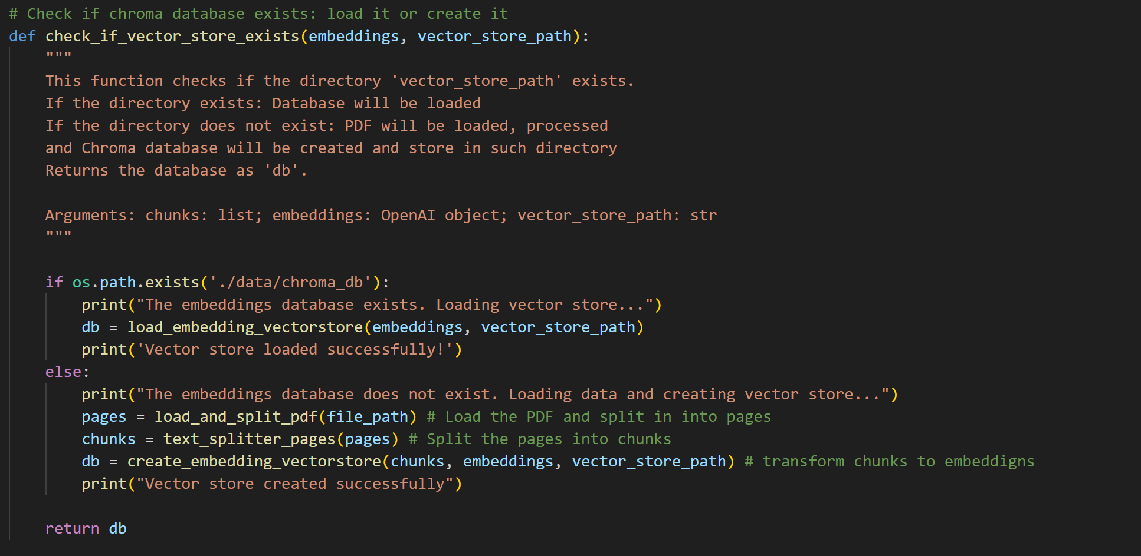
DATA TO EMBEDDINGS. CHROMA DB
Load vector store
or
Create vector store
Data Science | Machine Learning

Slide 6
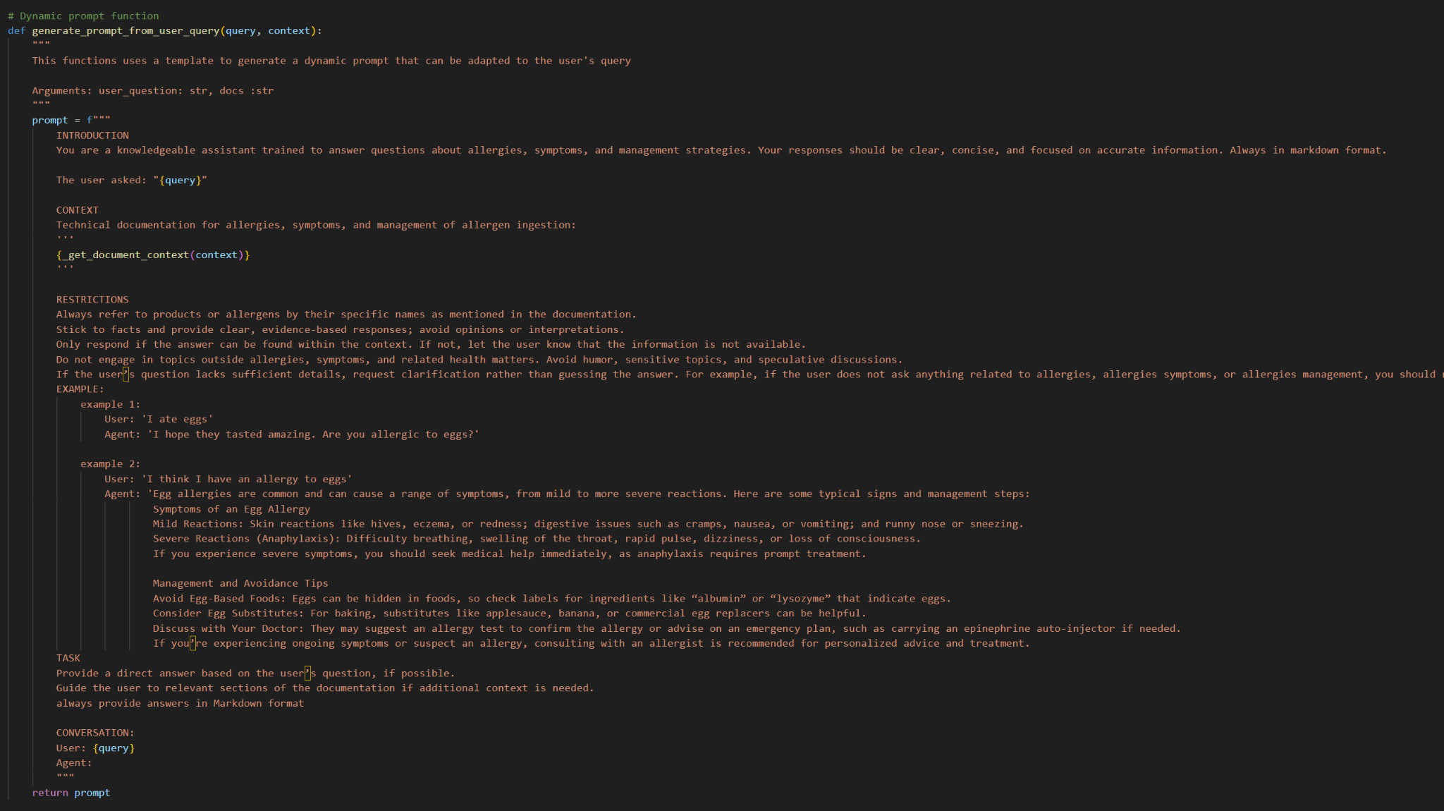
THE PROMPT
Assign his task
Set restrictions
Incorporate the context
Examples
Markdown format
Data Science | Machine Learning

Slide 7
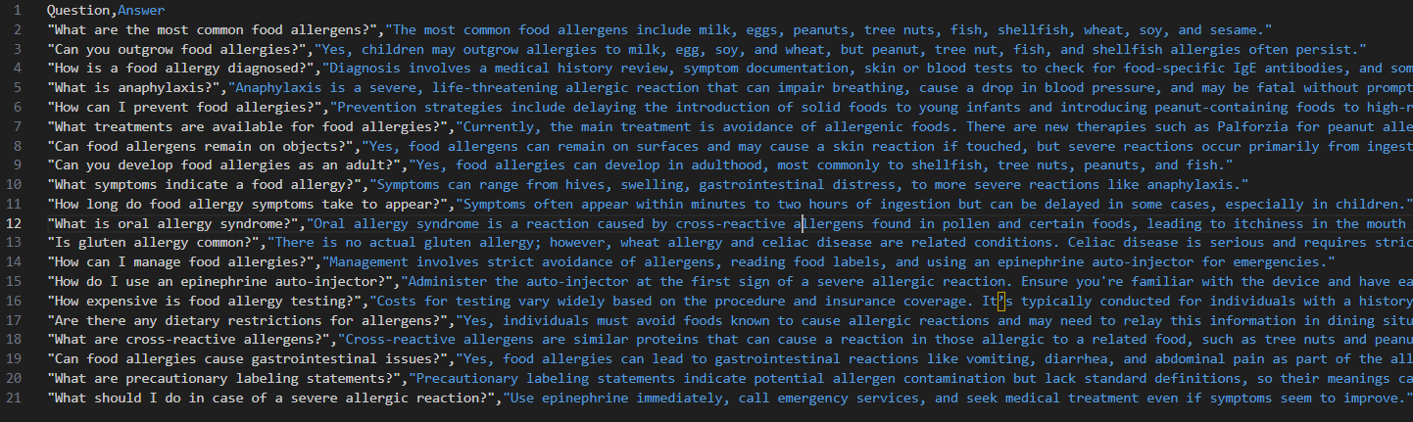
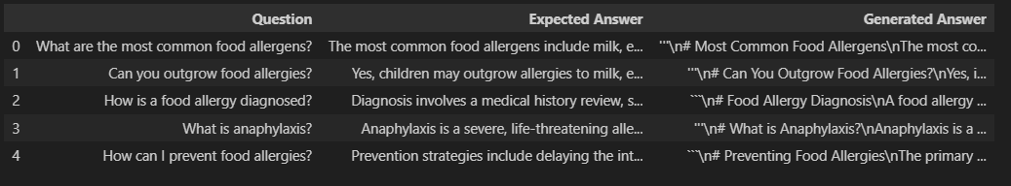
EVALUATION
Create a dataset with 20 Q/A about allergies
2. Generated answers by OpenAI Assistant
Data Science | Machine Learning

Slide 8
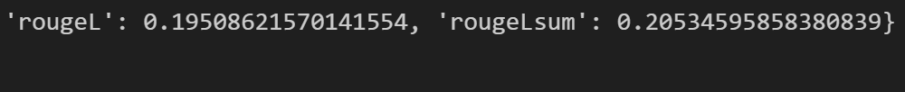
EVALUATION
Straight from chat GPT
with OpenAI + prompt + vector store
Data Science | Machine Learning

Slide 9
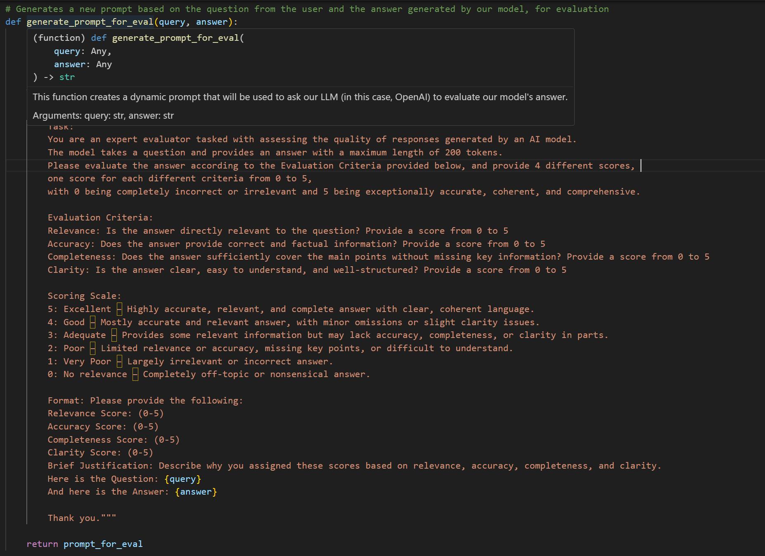
LLM AS A JUDGE
Train our OpenAi assistant to
evaluate our model’s answer with certain criteria
Data Science | Machine Learning

Slide 10
DEPLOYMENT: STREAMLIT APP
Ask our allergy assistant about any question related to allergies:
You will get your answer back
The answer will be scored
Upload any additional pdf you want to be used
Data Science | Machine Learning

Slide 11
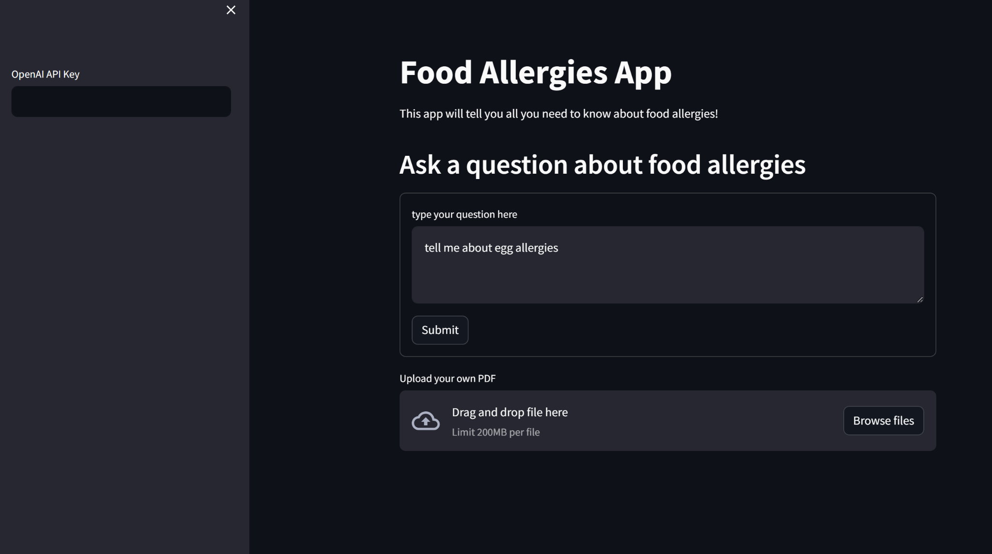
DEPLOYMENT: STREAMLIT APP
Data Science | Machine Learning

